Slide 1
Finance and Risk Analytics: Capstone Project
By Cassia Rodrigues

Slide 2
Agenda
Objective
Background
Key Findings
Recommendations
Appendix: Data Methodologies

Slide 3
Objectives
Use the elements of technical analysis to understand the trend of the underlying stocks
Construct visualizations to compare the performance of the available securities against each other, and also against the market index, S&P500
select the appropriate stocks for the portfolio in alignment with investor persona

Slide 4
Background
We have information for 24 stocks of leading companies listed in the New York Stock Exchange
The information for every stock ranges from 1st October 2010 to 30th September 2020
The stocks belong to different domains namely: Technology/IT, Travel/Aviation/Hospitality, Banking/Financial Services and Insurance, Pharmaceuticals/Healthcare/Life Sciences

Slide 5
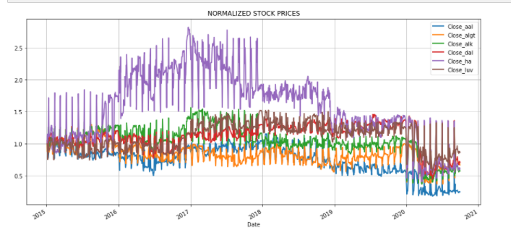
Aviation sector
Key:
AAL- AmerIcan Airlines grp
ALGT- Allegiant Travel Company
ALK- Alaska Air Group
DAL- Delta Air Lines
HA- Hawaiian Holding Inc
LUV- Southwest Airlines Co.
Closing stock prices for the different companies in the Aviation sector are shown above.
As we can see in 2019 all stocks dip, and in 2020 the stock prices have plummeted further.
We can understand that the Covid Pandemic is the reason for the dip.

Slide 6
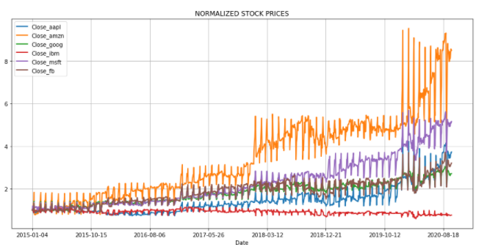
Technology sector
Key:
AAPL- Apple inc
AMZN- Amazon
FB- Facebook
GOOG- Google
IBM- IBM
MSFT- Microsoft
Closing stock prices for the different companies in the Technology sector are shown above.
As we can see the tech sector has boomed in the last few years, the Pandemic seems to have boosted the growth of these companies
There has been a steady increase in the valuation over the years, indicating that the industry is on an upward trend

Slide 7
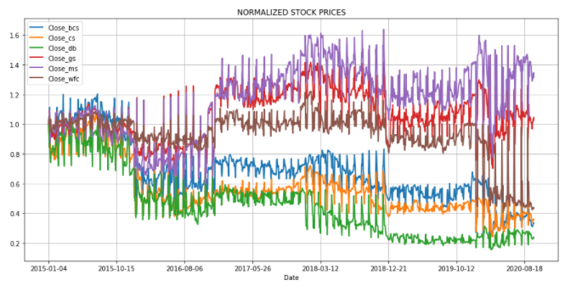
Finance sector
Key:
BCS- Barclays
CS- Credit Suisse
DB- Deutsche Bank
GS- Goldman Sachs
MS- Morgan Stanley
WFC- Wells Fargo
Closing stock prices for the different companies in the Finance sector are shown above.
The industry seems to be performing well overall despite a slump in 2018-19.
These stocks have a tendency to perform well in the future as well showing an upward trend.

Slide 8
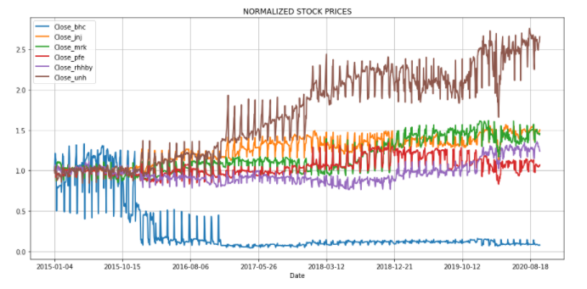
Healthcare Sector
Key:
JNJ- Johnson & Johnson
MRK- Merck and CO inc.
PFE- Pfizer
UNH- United Health Group
BHC- Bausch Health Companies inc
RHHBY- Roche Holding AG
Closing stock prices for the different companies in the Healthcare sector are shown above.
This industry was not performing well before the pandemic but due to increased importance in healthcare due to the pandemic these companies have outperformed
BHC is the exception due to various lawsuits and UNH is the top performer

Slide 9
Patrick’s Risk Appetite
Patrick would like to choose stocks that are not too risky; Conservative investor
Available capital of $1 M: 500K in Naturo and 500K in equities
He wants to double his capital in 5 years with less risk

Slide 10
Suggestions For Patrick
Stocks chosen:
AMZN
AAPL
HA
DAL
UNH
Option 1:
AMZN and AAPL both yield high returns, HA and DAL are less correlated with the first two stocks chosen and hence is suitable for a diversified portfolio. It's observed that UNH is moderately correlated and do provide good returns.
The returns are beyond the expectations for the investor (we need 100% return and we're receiving 200%), and the Sharpe Ratio is nearly 1, which indicates good rate of returns for the risk.
Considering client risk portfolio we can opt for these stocks in the portfolio

Slide 11
Suggestions For Patrick
Option 2:
Stocks chosen:
MSFT
AMZN
GOOG
LUV
UNH
AMZN, GOOG, MSFT yield high returns, but all from same industry tech, therefore some element of rick but not in the foreseeable future
Here we can see that the returns have increased to 248%, the risk has reduced and Sharpe Ratio has also stayed quite the same at 0.73 which is close to to 1.
Thus this portfolio can be recommended to Patrick

Slide 12
Peter’s Risk Appetite
Peter is a risk taker, and prefers high return investments
Wants to invest $1M from company into high-margin stocks
Expects high returns in the next 5 years for expansion of company

Slide 13
Suggestions For Peter
MSFT
AMZN
FB
HA
AAPL
Option 1:
Stocks chosen:
MSFT
AMZN
FB
HA
AAPL
Four technology stocks have been chosen in driving up the risk factor all in one industry due to consistent performance.
The returns are pretty high at 268% with the Sharpe Ratio also at a respectable 1.09.
With Peters risk appetite this portfolio is a good fit.

Slide 14
Suggestions For Peter
Stocks chosen:
MSFT
AMZN
GOOG
AAPL
UNH
Option 2:
Opting for UNH instead of HA to slightly reduce the risk
Returns have increased to 310%, Risk has decreased to 1.50,Sharpe Ratio has increased to 1.22m
This is a good portfolio for Mr.Peter.

Slide 15
Recommendations
As observed recommendation we can provide are:
For Mr. Patrick Option 1 is more suitable as it is less risky as option 2
For Mr. Peter Option 2 seems suitable as the returns are higher with high risk but lower risk than Option 1
Considering the risk profiles an appropriate decision can be ascertained

Slide 16
APPENDIX :DATA METHODOLOGY
For better understanding we have the attached the methodology document for your reference
We have explained the rationale behind the steps taken for the data preparation and analysis
Methodology document: Available in the zip file

